Slide 1
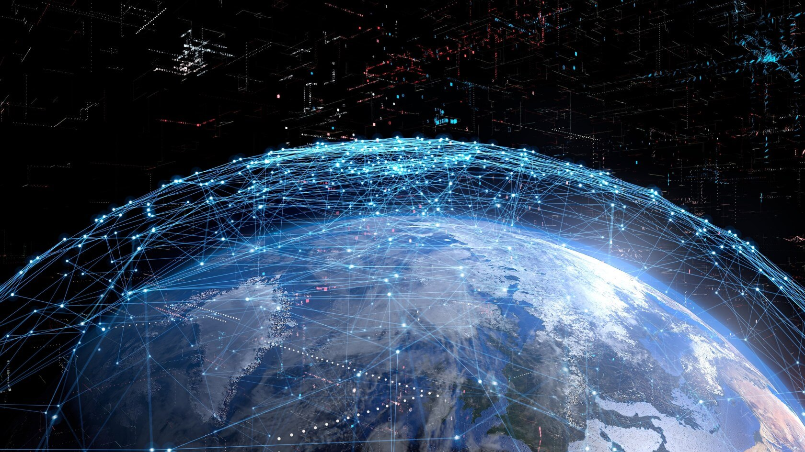
Starlink The sky is not the limit

Slide 2
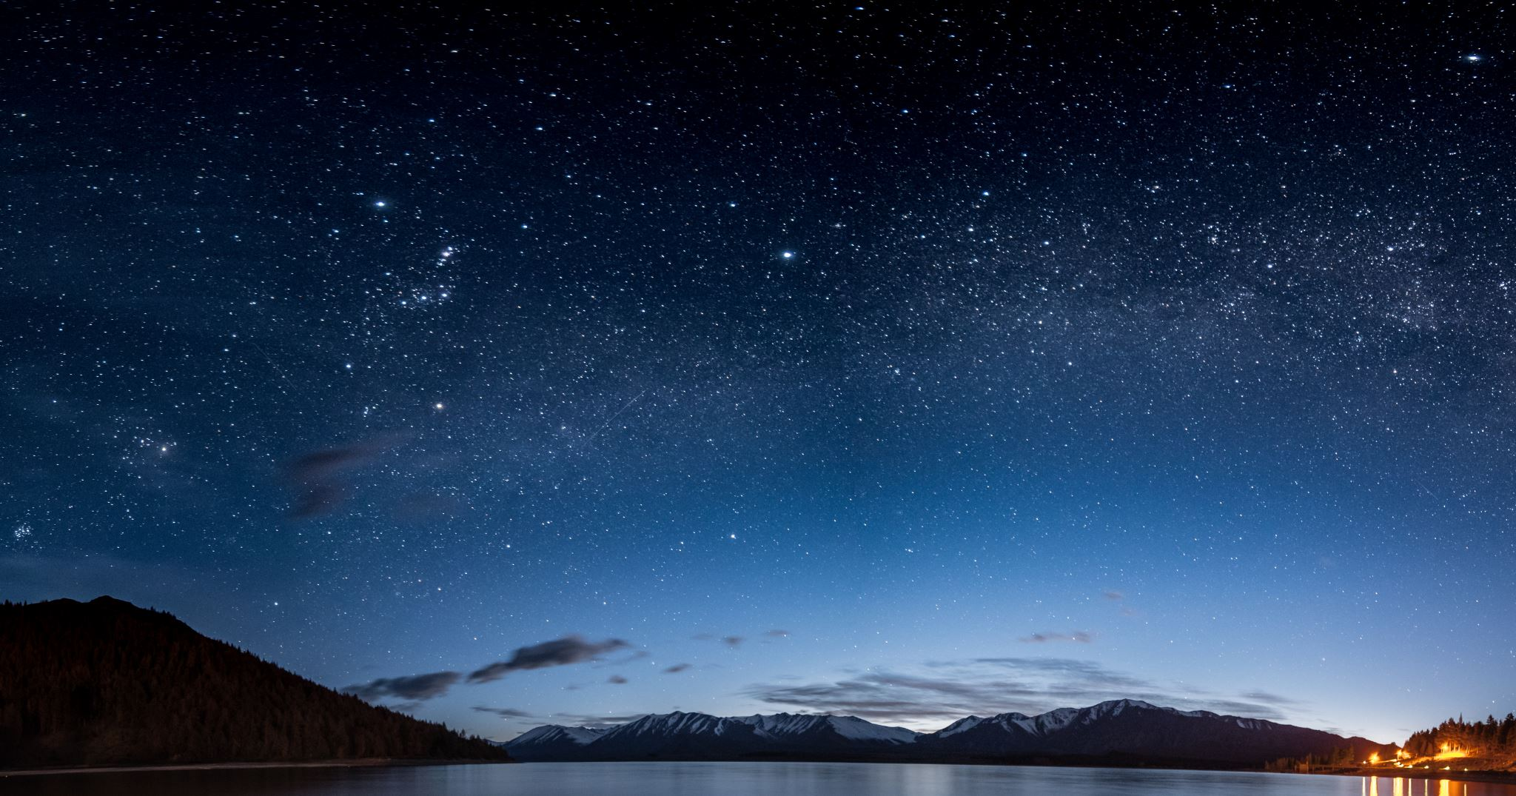
Index
Why now?
How are these any different?
Commercial Applications
Limitations
Costs
The future

Slide 3
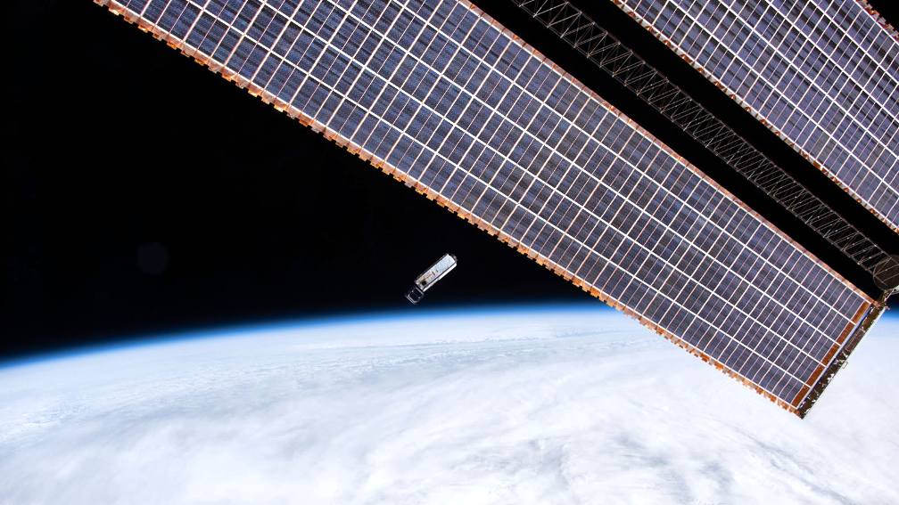
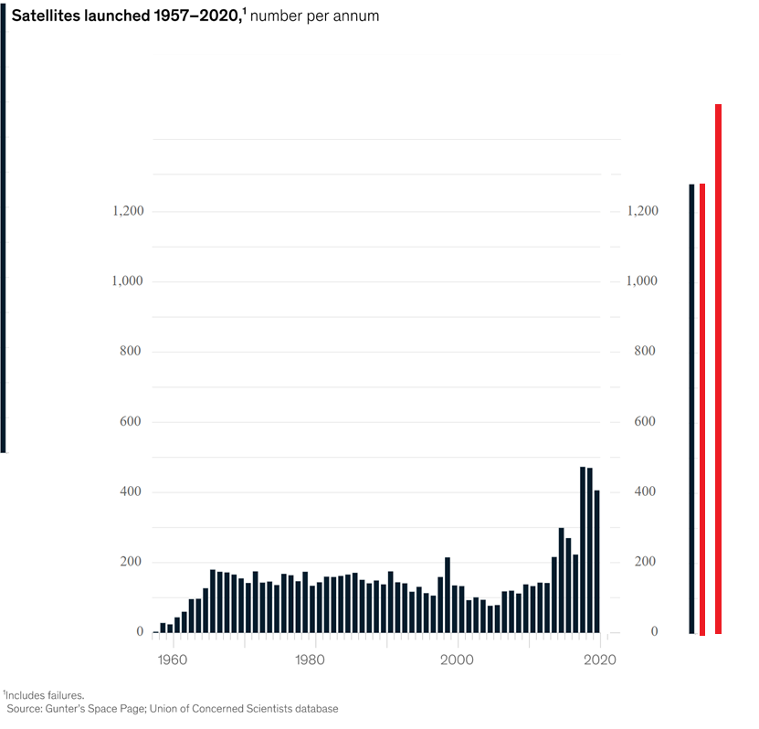
1,600
1,600
1,400
1,400

Slide 4
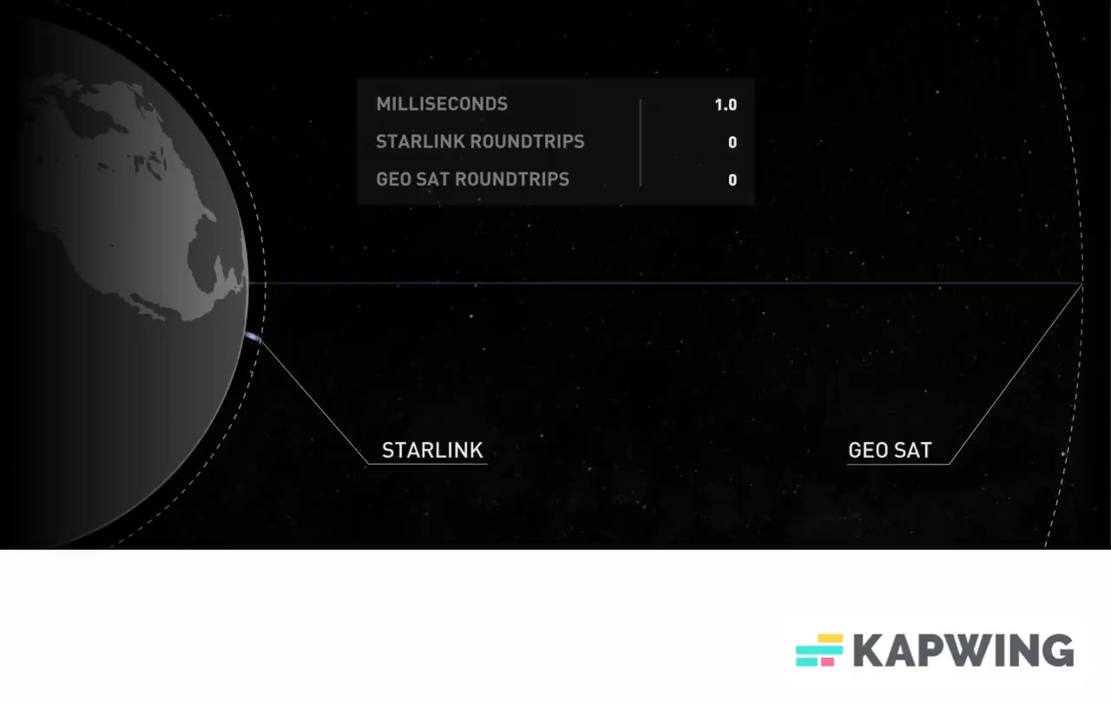
How are they any different?

Slide 5

How are they any different?
* small satellites
Notes:
Use “sky is not the limit”

Slide 6
Satellite Constellations

Slide 7
How are they any different?
Lesser
Launch costs
Higher
Observation frequency
Scale fragmented systems
Response times
Redundancy

Slide 8
Applications of small satellites
Earth and Science Observation
IoT and Communication
Science and Environment

Slide 9
Applications of small satellites
Security, Defence and National Space Programmes
Others
Asset Tracking

Slide 10
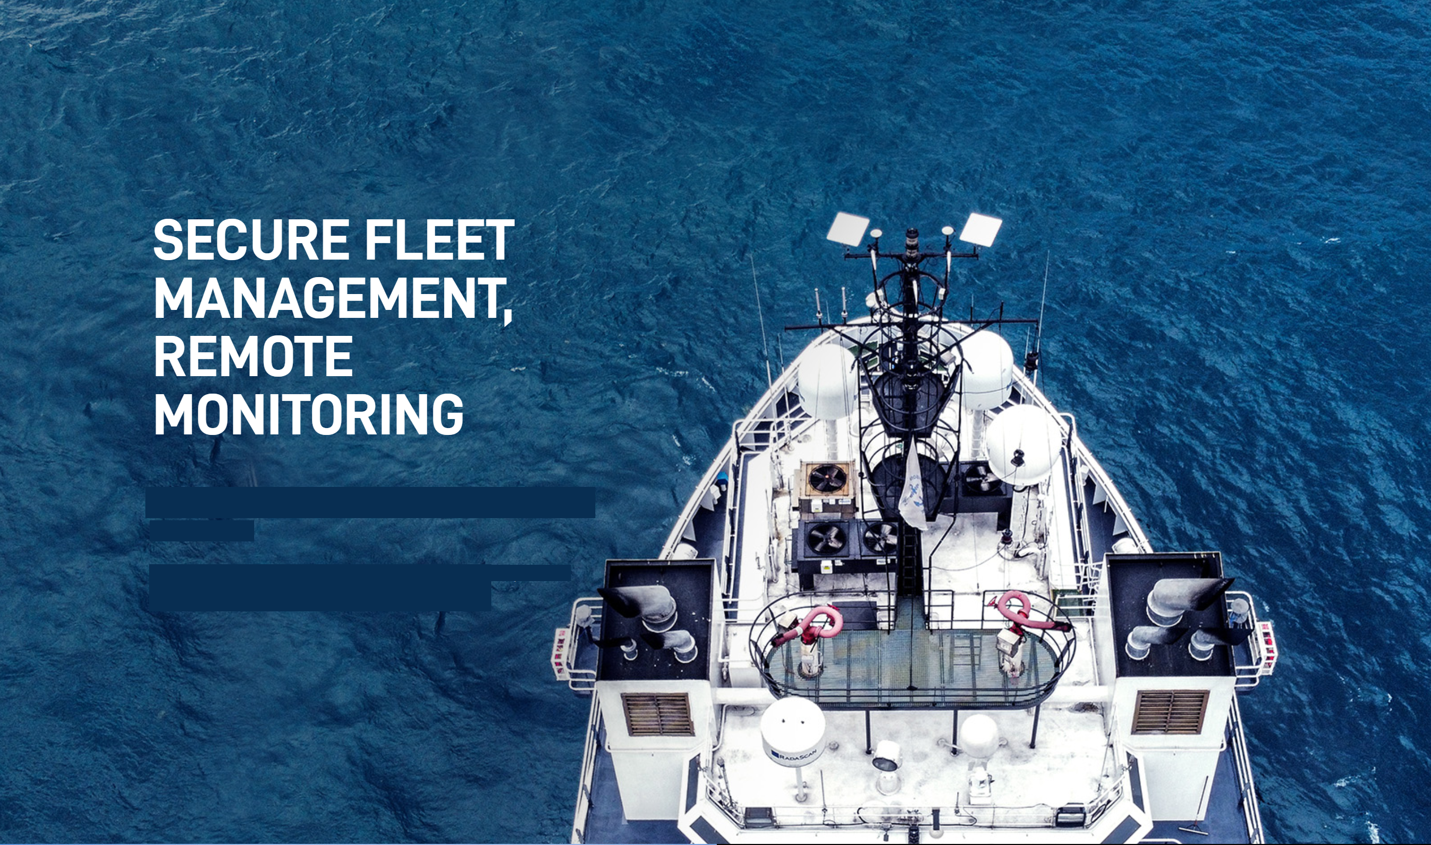

Applications
1.

Slide 11
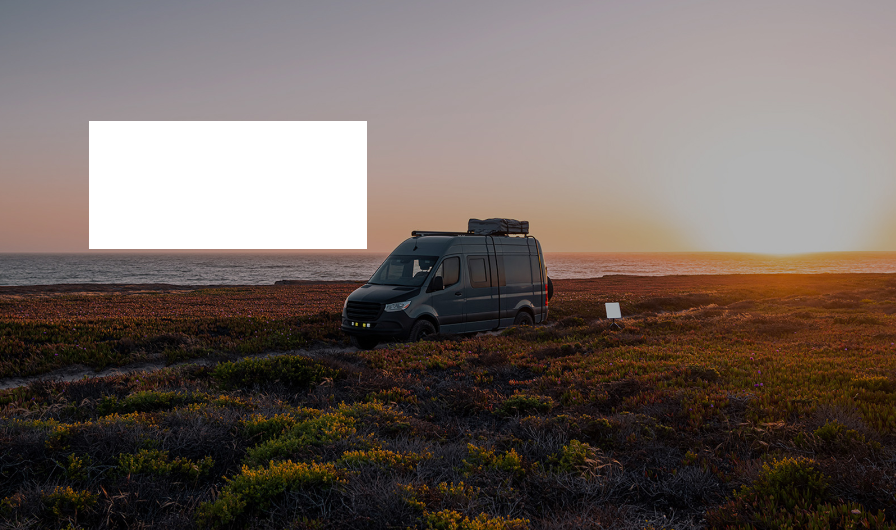
Work from “Home”

Slide 12
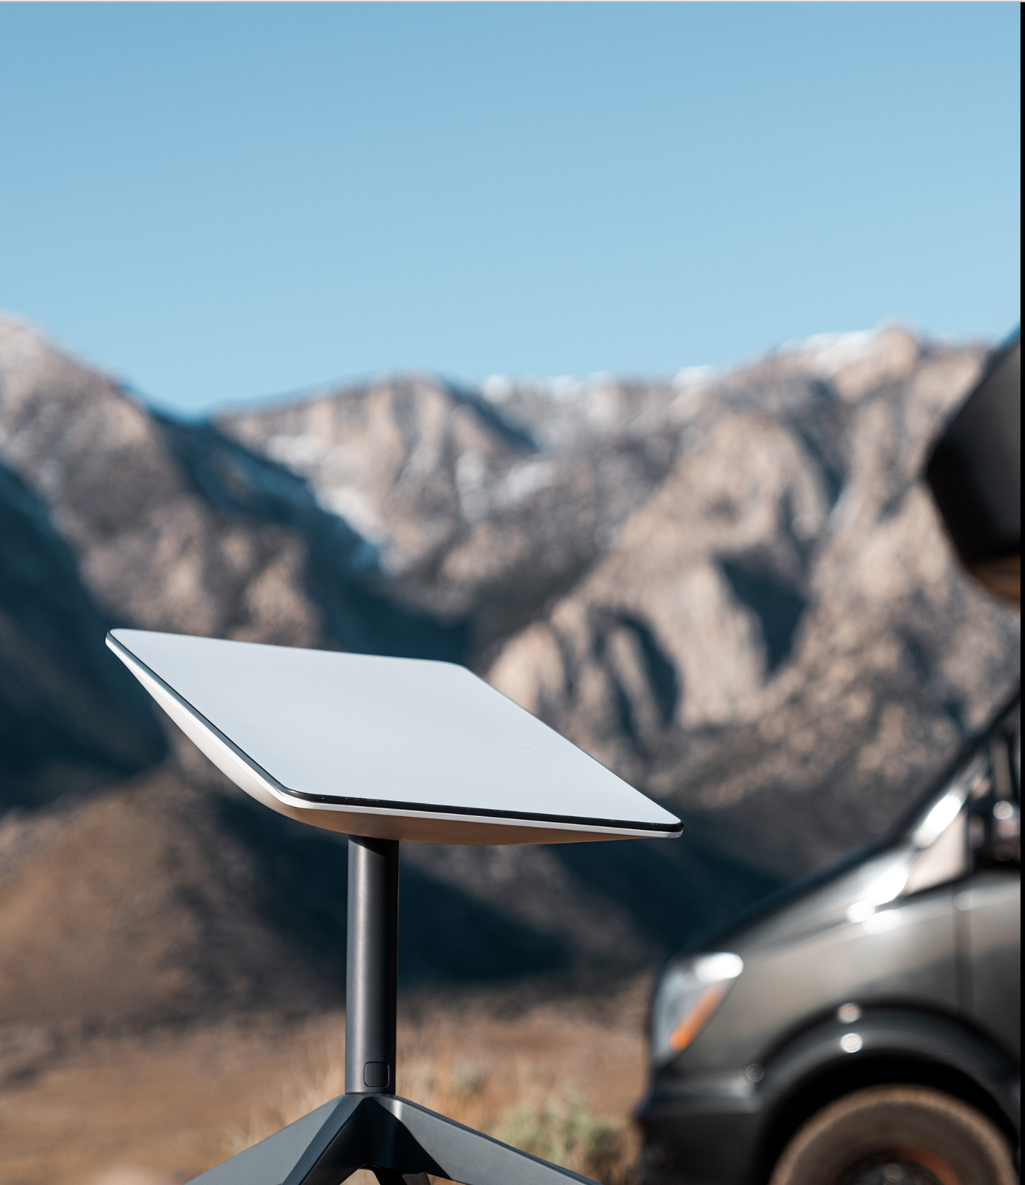

Applications
2.
Remote connectivity
Notes:
Mention Apple satellite feature

Slide 13
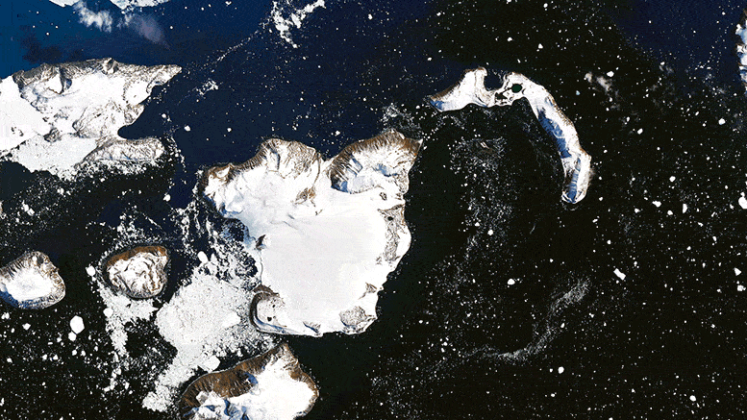

Applications
3. Earth Observation

Slide 14
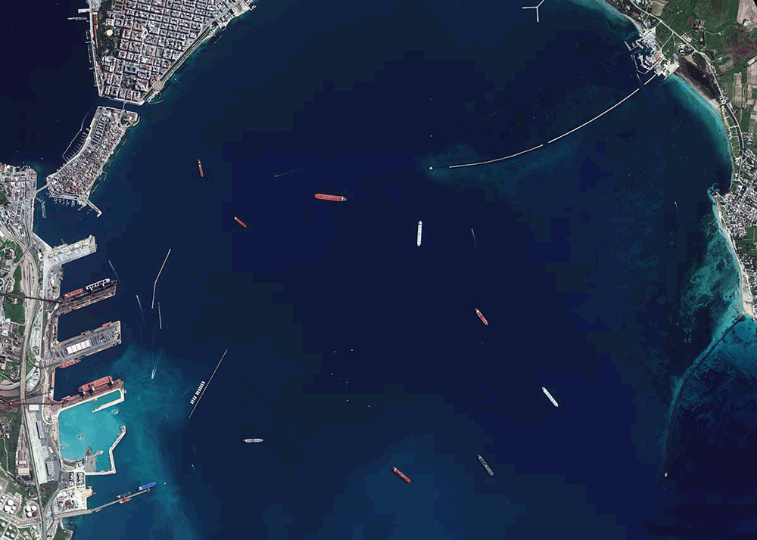

4. Security and Defense
Applications

Slide 15
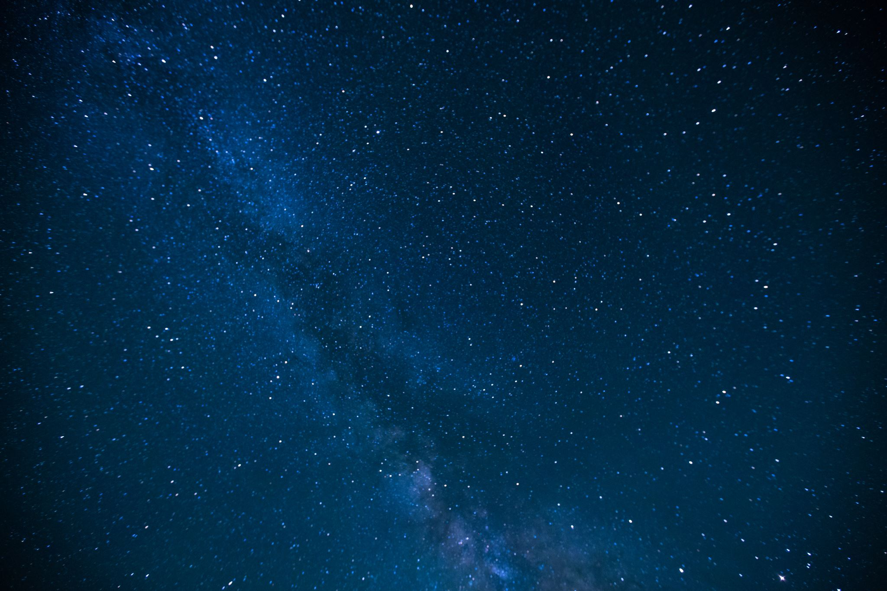
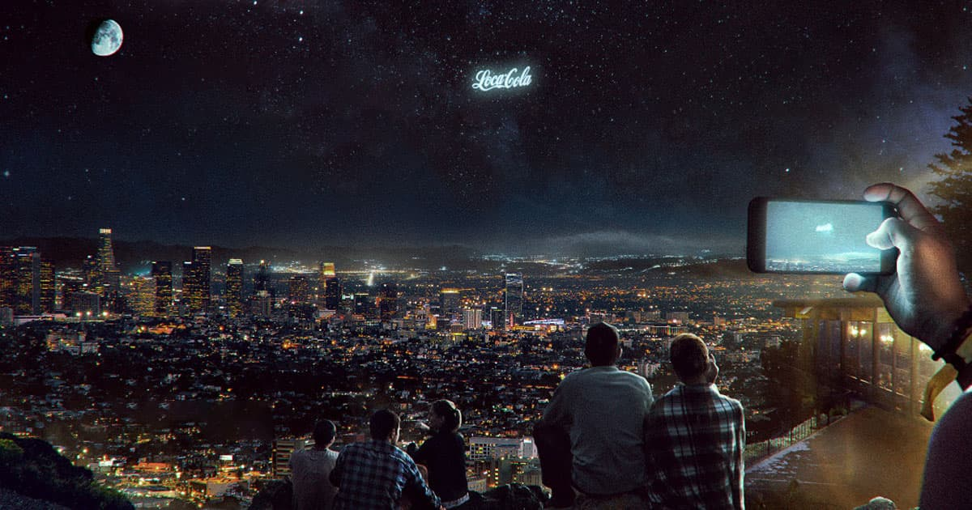
5. Other applications
Applications
Notes:
Japanese startup plans to launch a pair of microsatellites that will fire off artificial shooting stars on command. Space debris clean up (airbus) space funeral mission

Slide 16
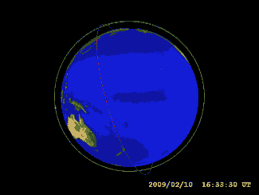
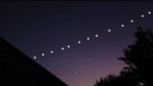
Space debris
Concerns being addressed
Space research obstructions

Slide 17
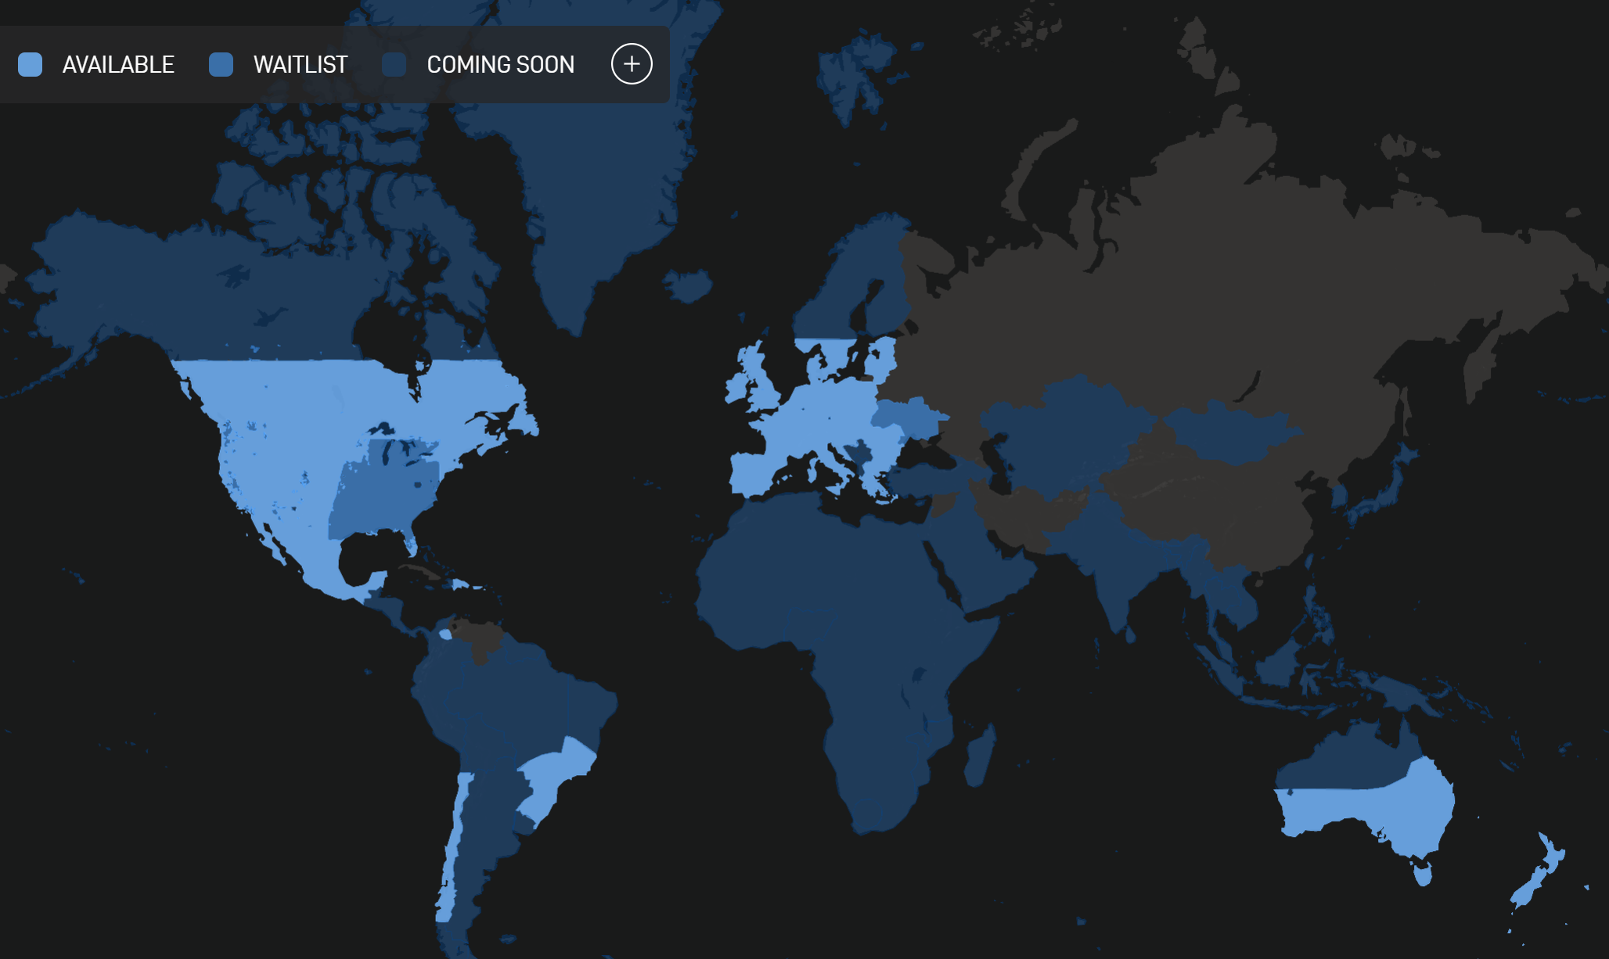
Geographic coverage of Starlink (as of Q3 2022)

Slide 18
What am I missing out on?
Company | Starlink | Fiber | Cable | Cellular
Download Speed
Upload Speed
Latency
Price
Availability Rural
Availability Urban
Reliability
Notes:
Use “sky is not the limit”

Slide 19
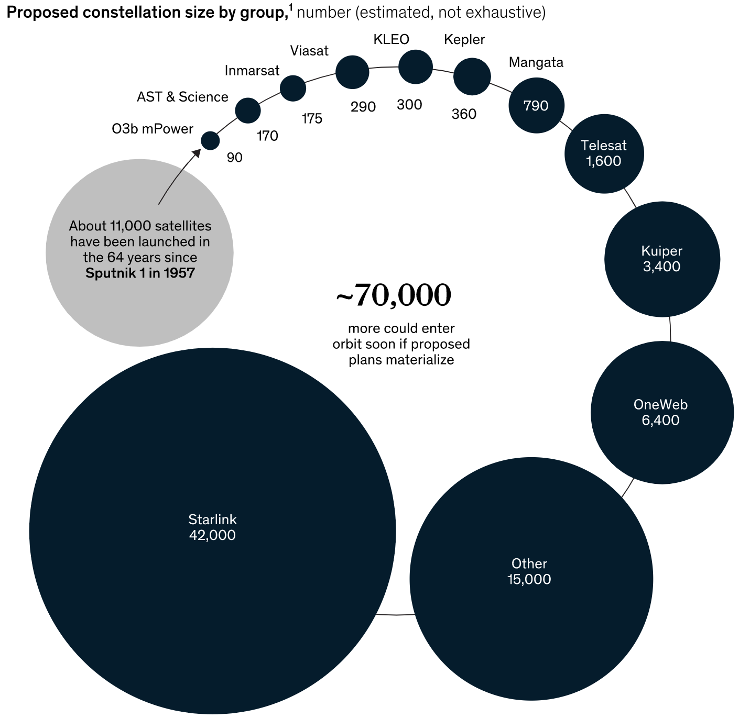
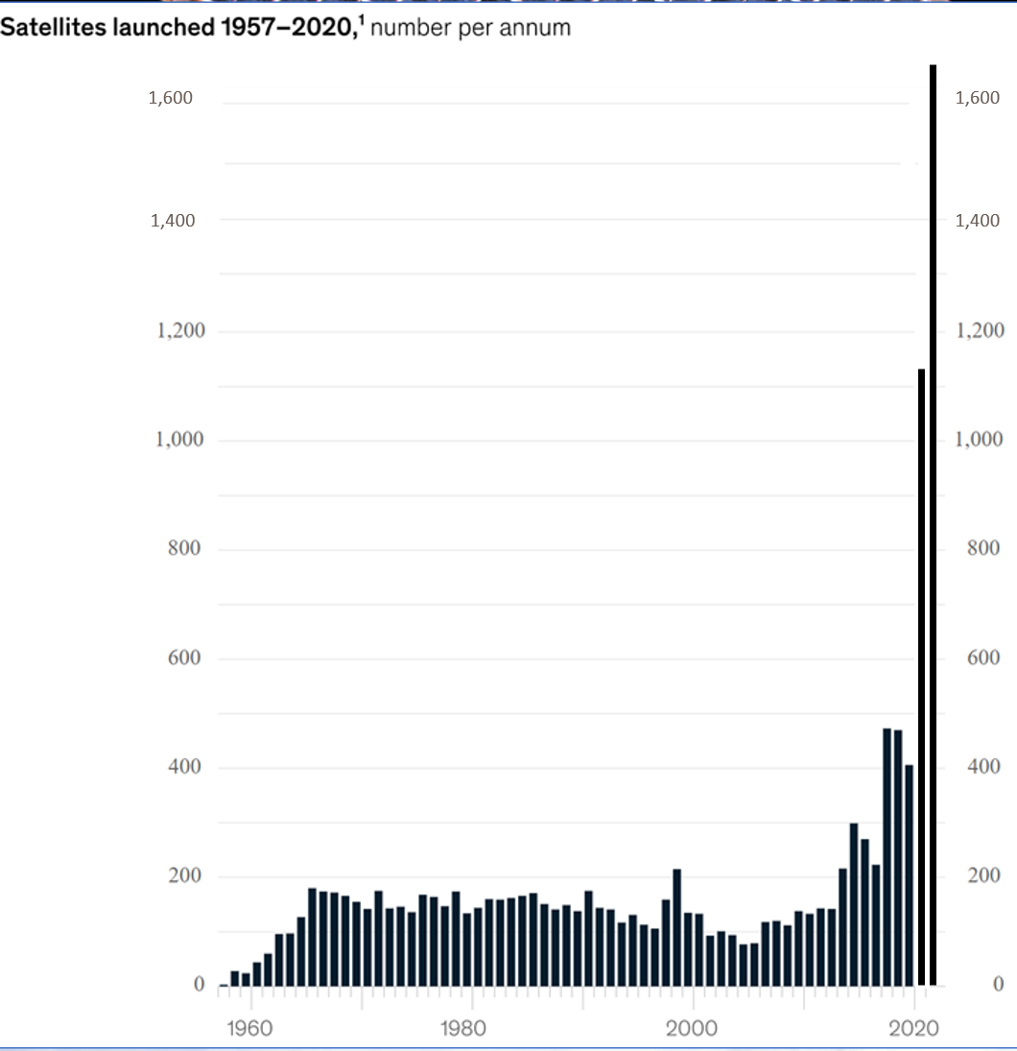

Slide 20
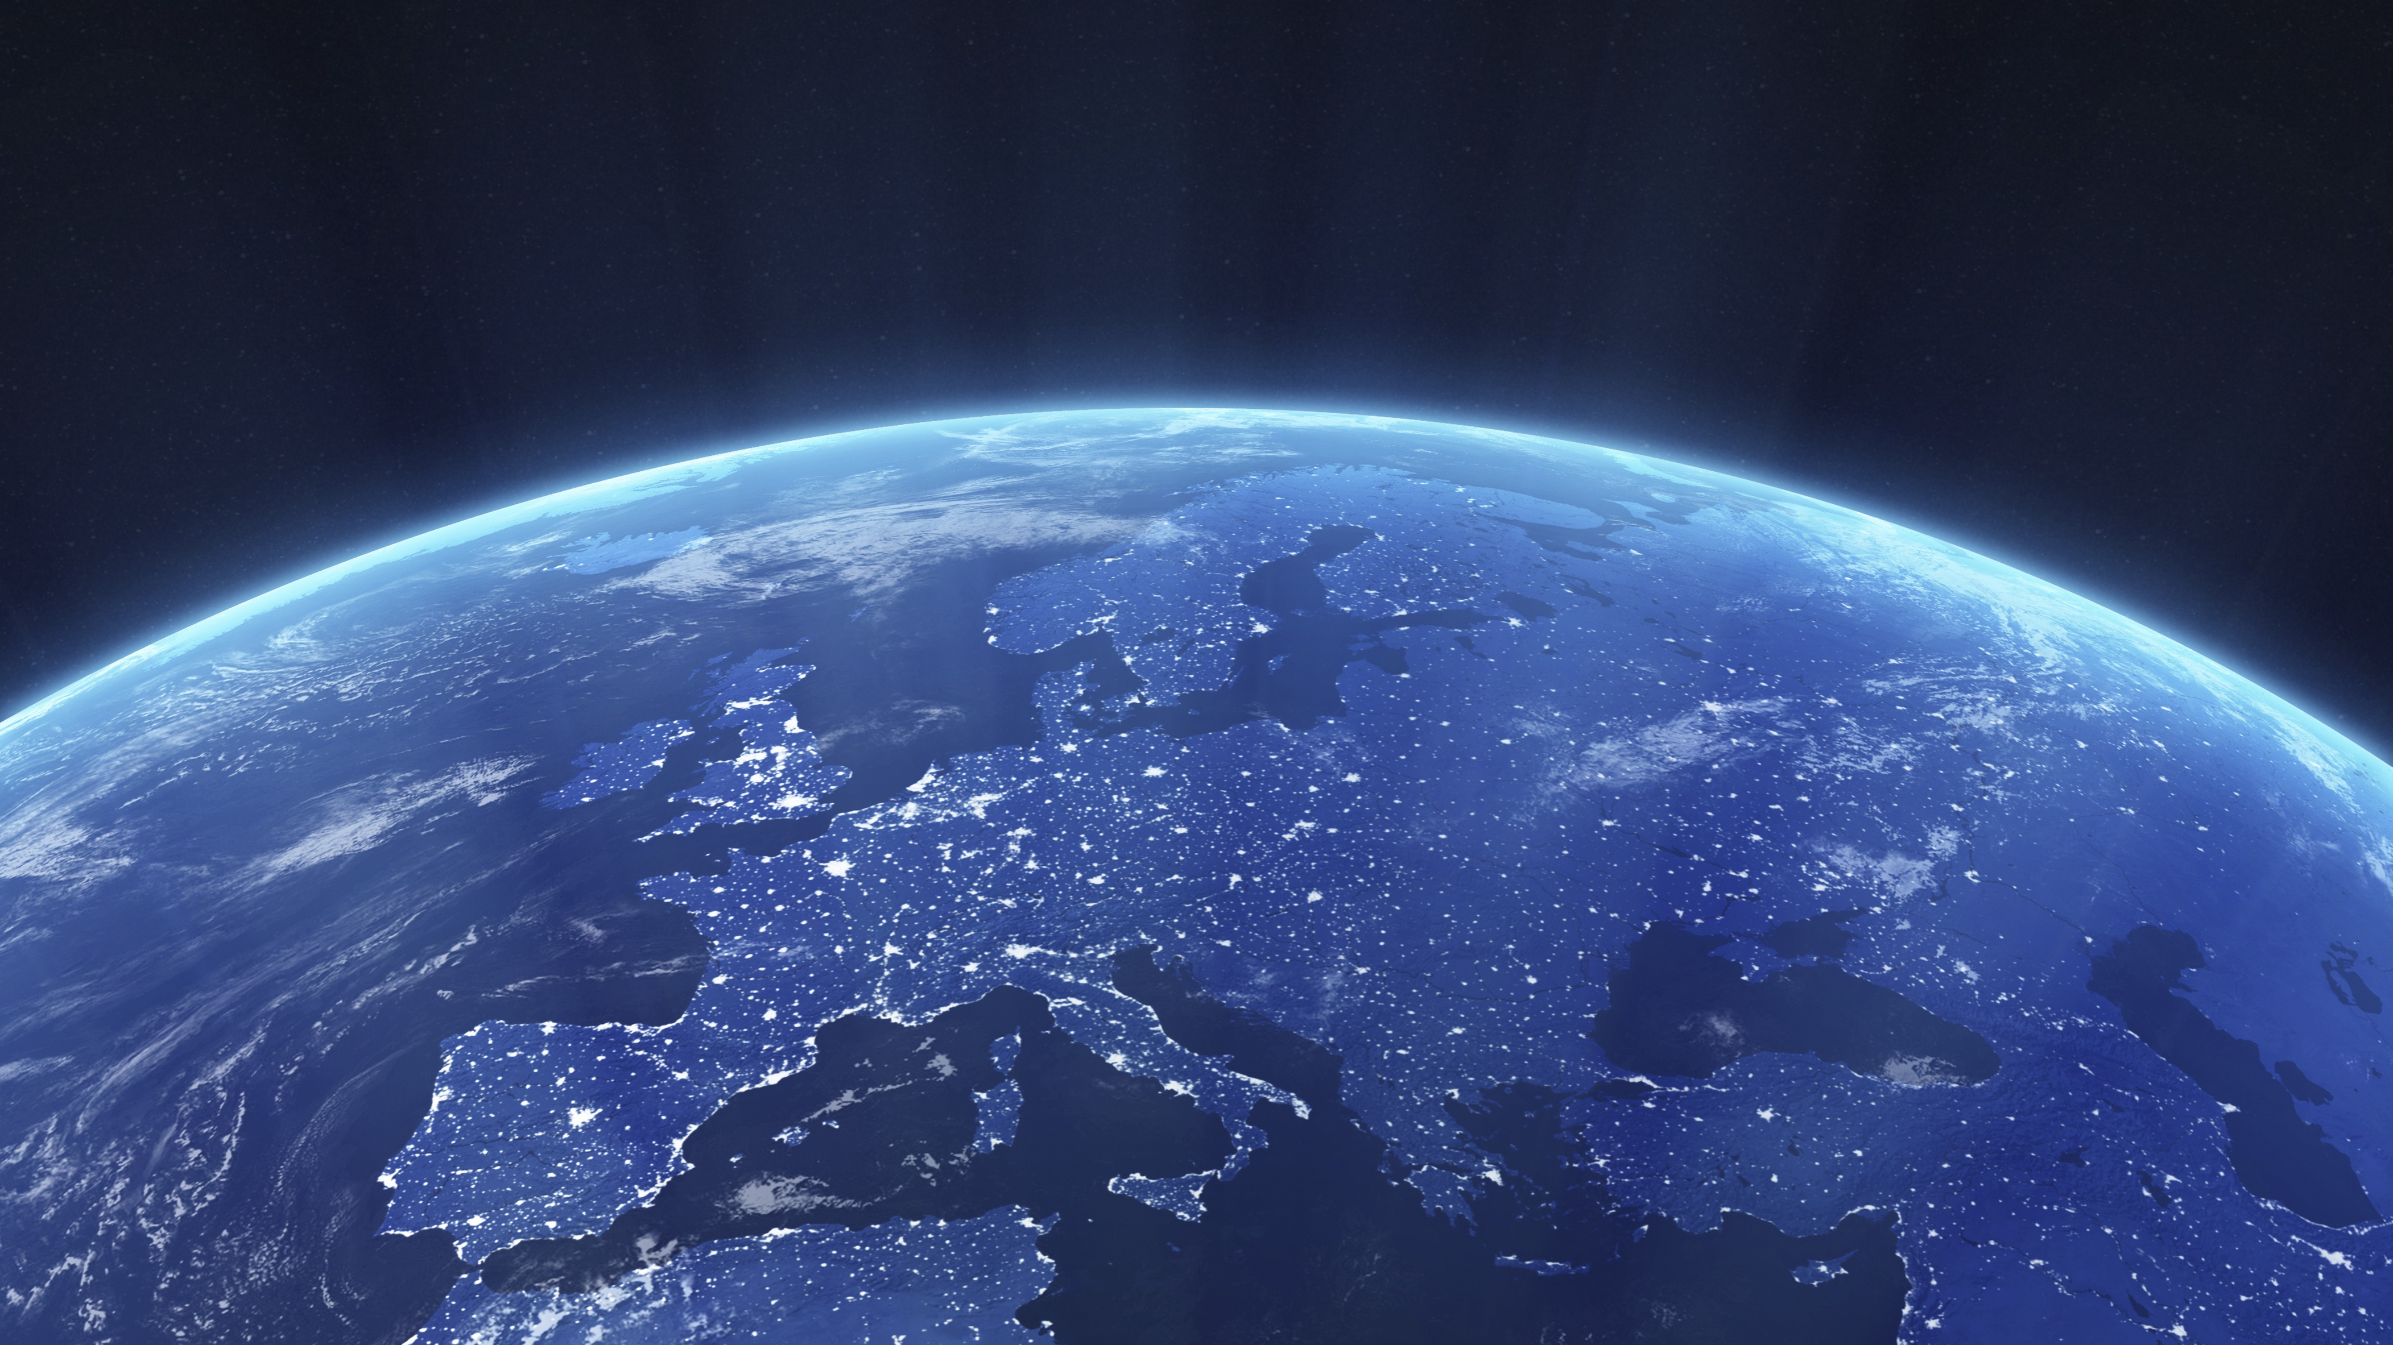
The sky is not the limit

